Slide 1
Springboard Data Science Career Track - Capstone Project 2
Weijung Tseng 09/20/2021
Bitcoin Price Prediction

Slide 2

Can we predict Bitcoin price?
NOTE:
To change images on this slide, select a picture and delete it. Then click the Insert Picture icon
in the placeholder to insert your own image.

Slide 3
Project Objectives
Learning Objective:
This capstone project summarizes the knowledge and skills of program participants in the data science career track as demonstrated in the project workflow from data gathering, wrangling, analysis, modeling, summarizing, and recommendation for action plans.
Business Objective:
Using the findings and conclusions from this project are useful for individual investors, banks, and financial institutions.

Slide 4
Background
Cryptocurrency has been one of the hottest topics in the last few years, especially in the younger generations.
A cryptocurrency is basically a digital and encrypted asset that uses blockchain technology along with computers to stand alone on the web without any central party’s control.
Nevertheless, many people believe the potentials of the cryptocurrency due to its convenience of fund transfer without third party making a cut as the middleman. The transactions between cryptocurrency holders are beyond boundaries of countries, which makes it possible for money laundry and other crimes but still doesn’t lower too much of the greatness of the currency.
Recently, some big companies like Tesla and MicroStrategy have invested in Bitcoin, the most well-known cryptocurrency, either to make profit or to hedge.

Slide 5
Methodology
The following methodology was adapted to predict bitcoin price:
Dataset: Identify where to find the required data and data retrieval
Data Wrangling: Once the data is identified and retrieved, basic data preprocessing and quality control are conducted
Data Exploration: When the data is ready for exploration, apply statistical methods to identify data clusters, correlations, and trends
Data Modeling with Machine Learning for Prediction: With basic understanding of the data, more advanced data analytics of machine learning is applied to the data to build predictive models
Summary: conclusions and recommendations

Slide 6
Dataset
There were two dataset I used in this study: 7 most popular cryptocurrency prices and social media data
Cryptocurrency prices: contains the following crypto currency prices: Bitcoin, Ethereum, Cardano, Binance Coin, Tether, XRP, and Dogecoin. The data was pulled using coingecko.com’s api from https://api.coingecko.com/api/v3/coins/btc/market_chart?vs_currency=usd&days=100
Social Media data: contained the following data related to bitcoin: Facebook likes, twitter followers, reddit average posts in the last 48 hours, reddit average comment in the last 48 hours, reddit subscribers, and reddit active accounts discussing in the last 48 hours. The data was pulled using coingecko.com’s api from
https://api.coingecko.com/api/v3/coins/btc/market_chart?vs_currency=usd&days=100

Slide 7
Data Wrangling
Any extraneous data was removed
Rows and Columns containing redundant data
Columns that held only descriptive information
Features for Data Exploration and Machine Learning were identified and prepared
Converting and combining datetimes
Adding features:
Adding features to show difference in daily followers on social media

Slide 8

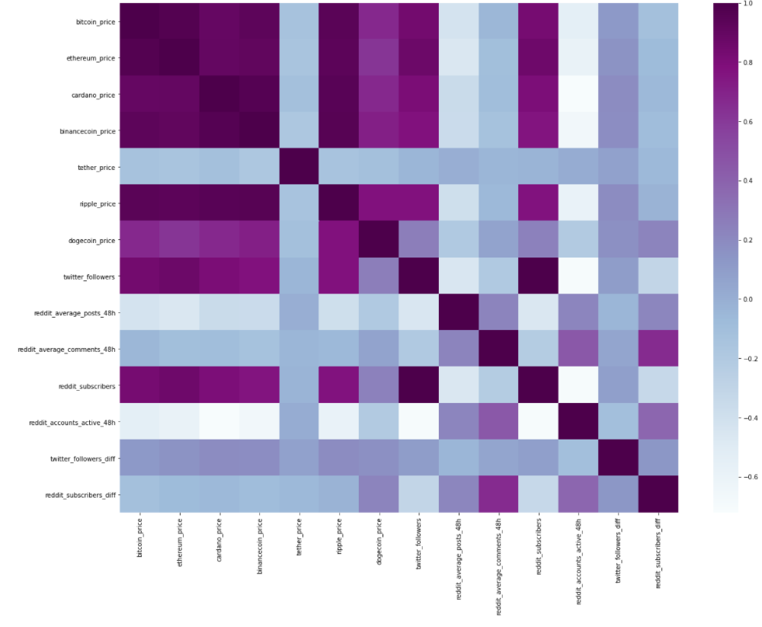
Data Exploration
Correlation Matrix

Slide 9
ML – Algorithms Used
As the goal of the data analysis is to determine bitcoin prices, a supervised machine learning classification method seems appropriate.
4 different models were built:
Linear Regression
Ridge Regression
Lasso Regression
Elastic Net Regression

Slide 10
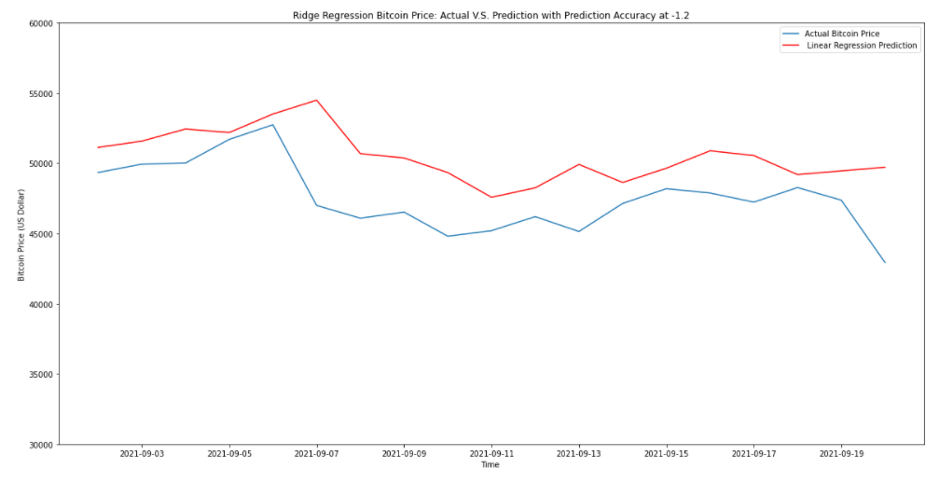
Results
The figure on the right was the best model I could find in the project, but the R2 score was negative at -1.2
Also, selecting more import features to build a new model didn’t help either.
Most important features:
Ethereum Price
Twitter Followers
One possible explanation of all the prediction being low was due to recent huge collapse in China’s housing sector and FED signaled bond-buying taper.

Slide 11
Recommendation for clients to use the findings
Using merely 6 other cryptocurrency prices and social media post and followers didn’t seem to provide good prediction on Bitcoin price. Investor on Bitcoin would need to discover more data.
Among all the findings, Ethereum price and twitter followers seem to be something we can keep in the future model because they are the most important features in the models built.
Bitcoin as the most popular cryptocurrency, it will be the first thing people liquidate which makes it highly unpredictable comparing with other equity that are hard to liquidate such as houses or gold. Therefore, recent negative or positive news may impact Bitcoin price heavily. Bitcoin can be traded 24-7 which doesn’t give investors time to digest good or bad news so the prices will fluctuate a lot in a short period of time after big news announcement. Investors should set up sell limit on Bitcoin to hedge themselves from huge loss.

Slide 12
Ideas for future studies
Stock and bond market seem to have high correlation with Bitcoin market. We could add that into future model to see if it makes improvement on accuracy.
Also, news regarding Bitcoin can be a good feature to consider.
We could also collect data from financial institute quarterly report to see if any Bitcoin has been purchased by them in the last quarter.
Instead of using a whole day as a unit, future studies can look at either hourly or even minutely data. However, the api I used in the study would not have that accurate of data.

